Slide 1

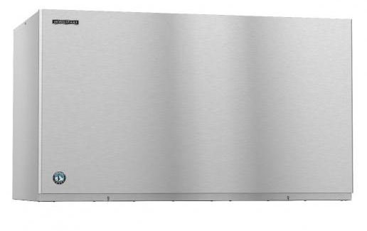

Icezone Installation Instructions for Hoshizaki KM Style Ice Machines
Please review the entire instructions prior to installation.
Caution: Installation should be done by a qualified technician using appropriate safety equipment and procedures.

Slide 2

INFORMATION
RECOMMENDED TOOLS
Follow the manufacturers guidelines for cleaning the ice and water dispenser thoroughly.
Before Installing Icezone, clean and sanitize the interior of the ice and water dispenser thoroughly according to the manufacturer’s guidelines. All surfaces should be free of slime and scale before starting the installation.
Hand Drill
Phillips Bit Driver
7/8” Step Drill Bit
¼” Nut Driver
Phillips Screwdriver
8-12 ft Ladder
Safety Goggles
Hose Cutter or Utility Knife
1 ¼” Crescent Wrench
Marker to mark hole locations
File or de-burring tool to de-burr holes

Slide 3
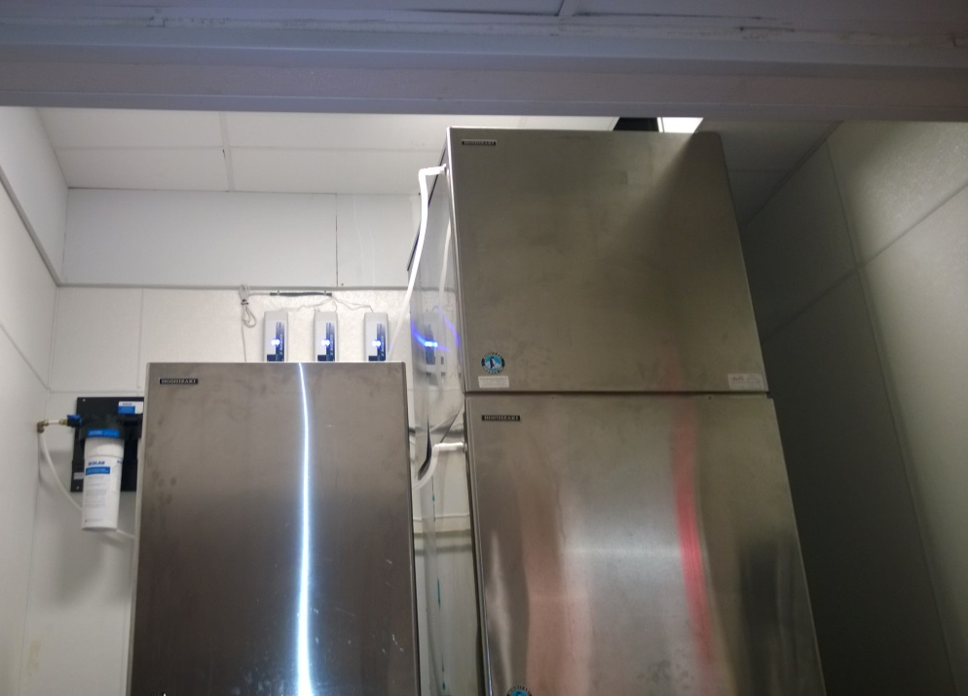
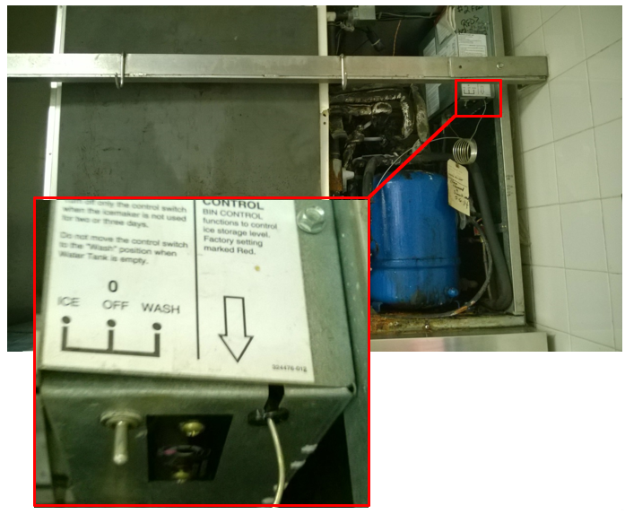
OVERVIEW
Before working on the ice machine, the ice in the bin must be removed.
Turn the ice machine power switch to the “off” position and disconnect power from the ice machine following facility appropriate lock-out / tag-out procedures.
These are Hoshizaki® KM Style ice machines in place above an ice bin in a typical restaurant installation.

Slide 4
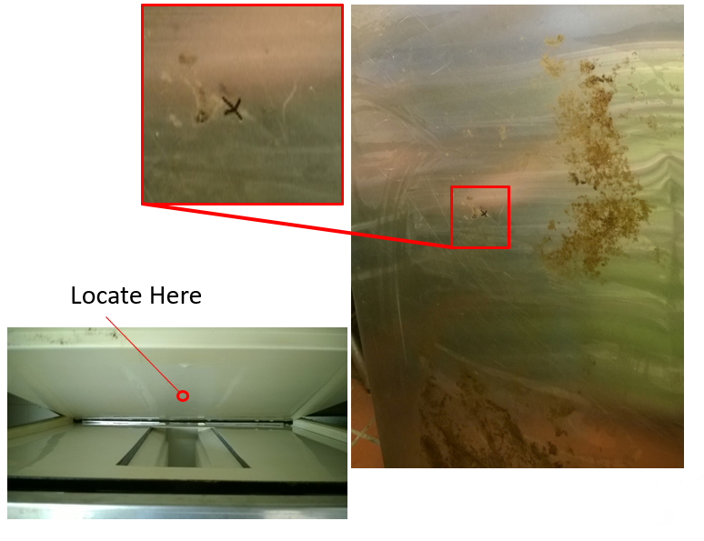
INSTALLING ICEZONE
FOR SINGLE MACHINE INSTALLATIONS
Mark the location for the Icezone supply fitting. This is the fitting where the plasma will enter the ice machine. This should be between the evaporators and should deliver plasma near the top of the ice production volume.
The first step is to locate the hole on the stainless-steel cover. The insulated cover can be removed to make this location easier to find.

Slide 5
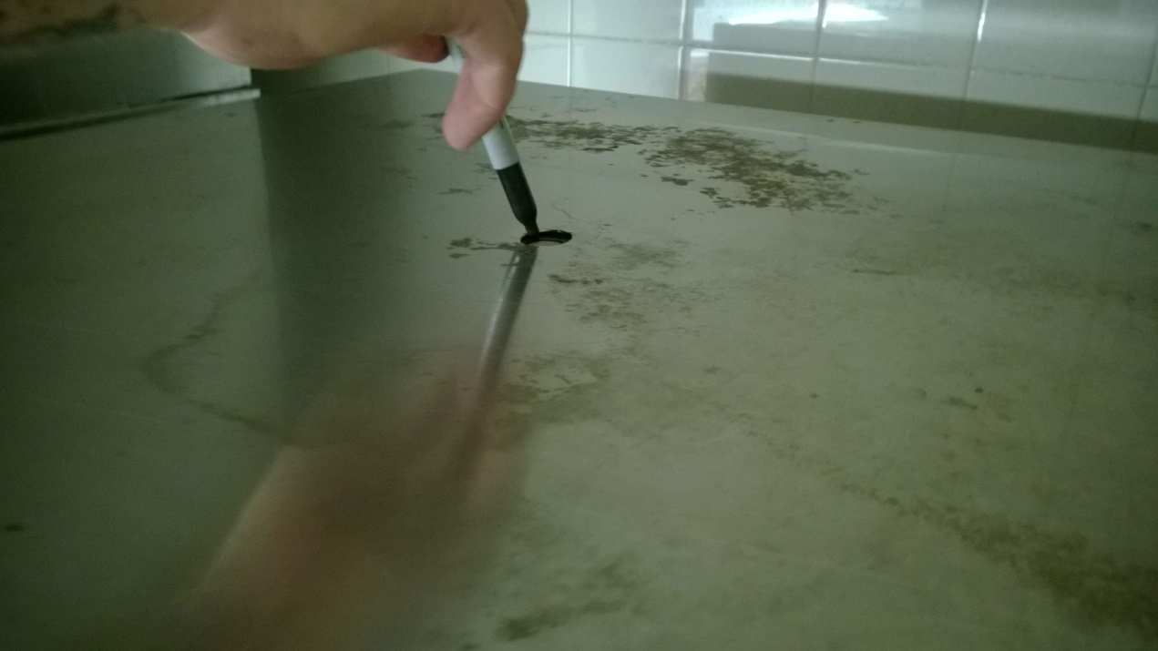
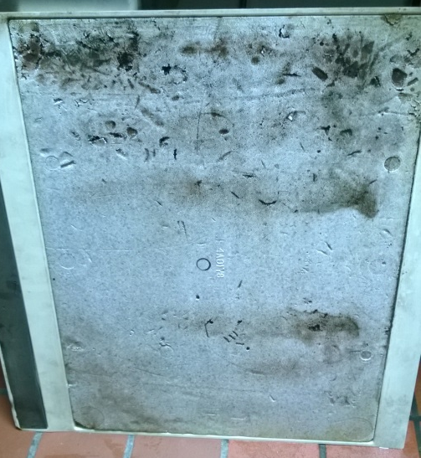
INSTALLING ICEZONE
FOR SINGLE MACHINE INSTALLATIONS
Transfer the location for the Icezone supply fitting to the insulated top cover by following these steps:
Place the stainless steel cover on top of the ice machine so it is seated in the normal operating position.
Mark the hole location in the insulated cover by marking with a pen though the hole in the stainless steel cover.

Slide 6
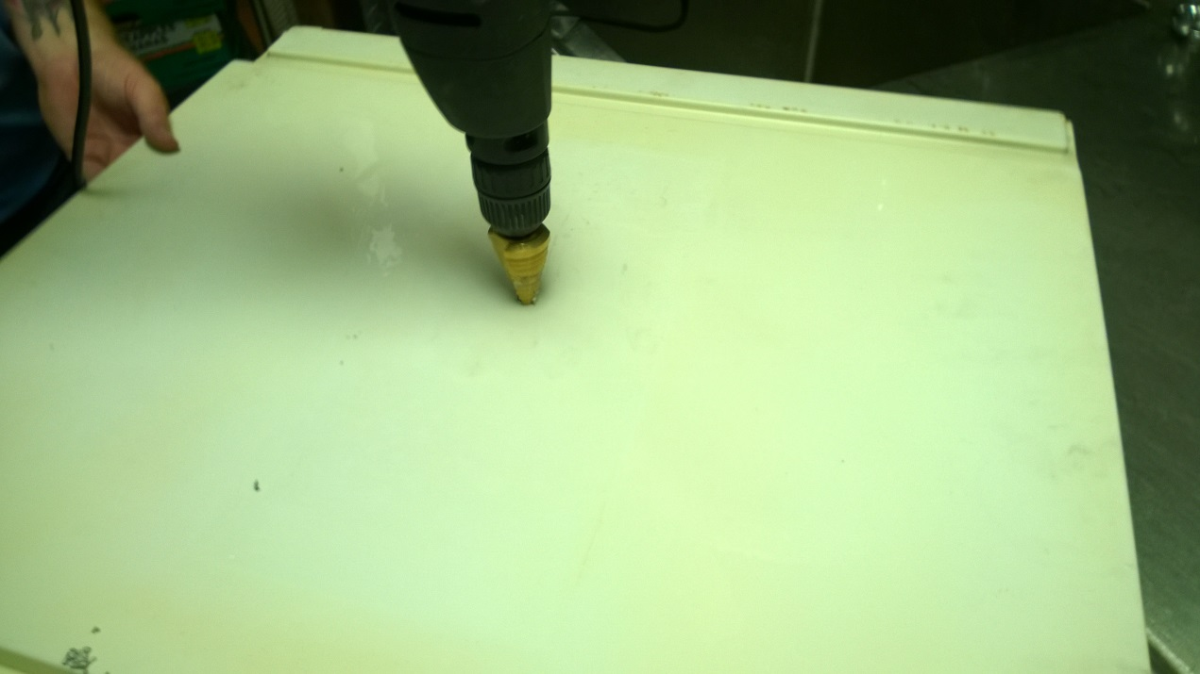
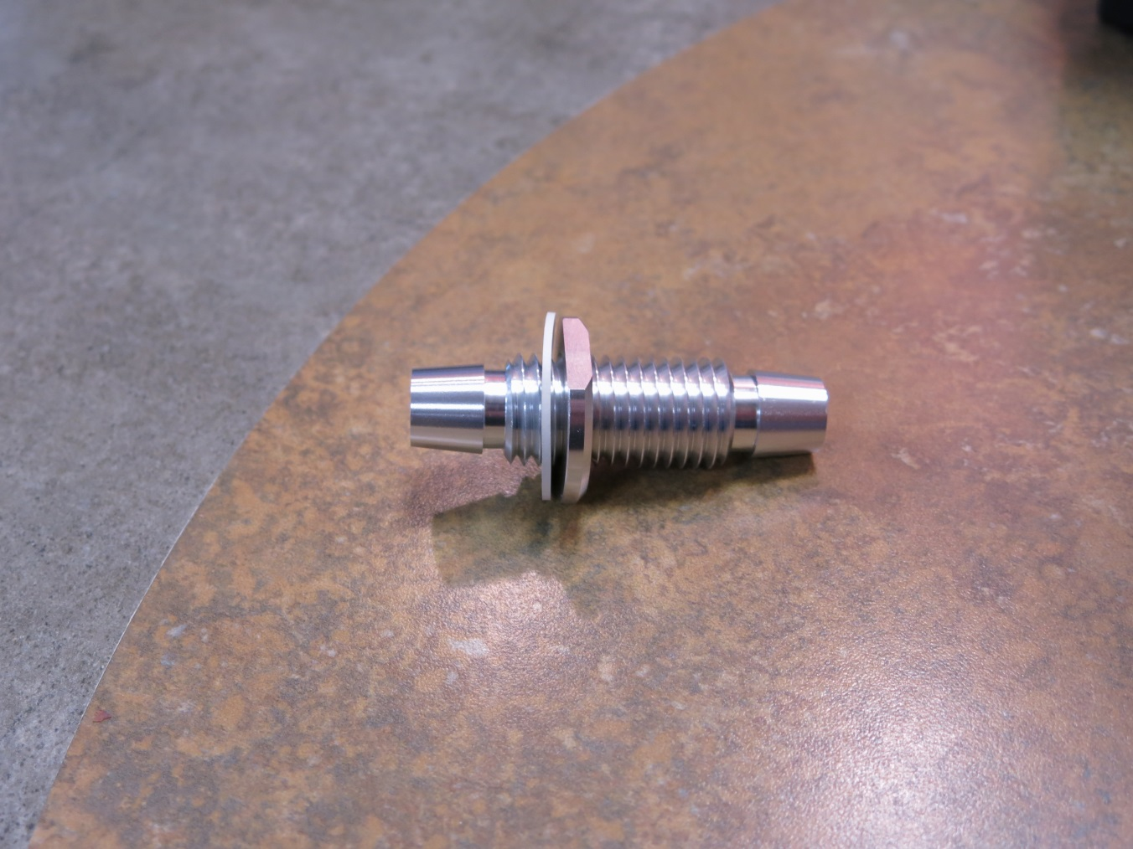
INSTALLING ICEZONE
FOR SINGLE MACHINE INSTALLATIONS
Assemble the supply fitting as shown.
This includes a double ended barb fitting, low profile nut and white rubber washer.
Drill the hole for the Icezone supply fitting in the insulated top cover at the mark transferred from the stainless steel cover.

Slide 7
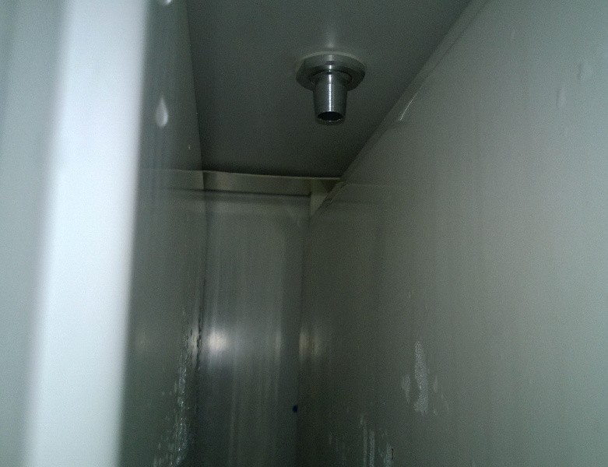
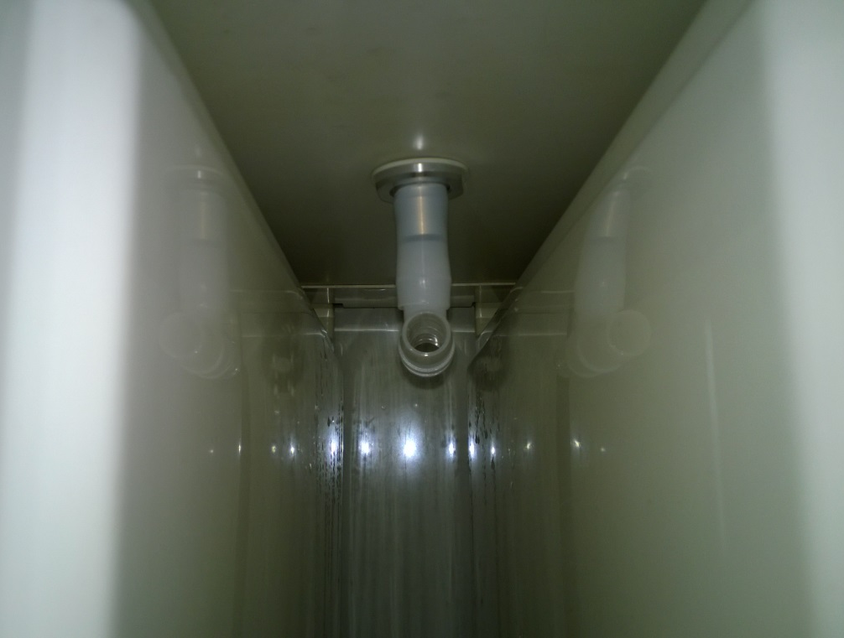
INSTALLING ICEZONE
FOR SINGLE MACHINE INSTALLATIONS
Install the supply fitting as shown.
This includes a second low profile nut and white rubber washer.
There should be no exposed threads on the interior surface of the lid per NSF guidelines.
Install the “T” fitting on the supply fitting as shown.

Slide 8
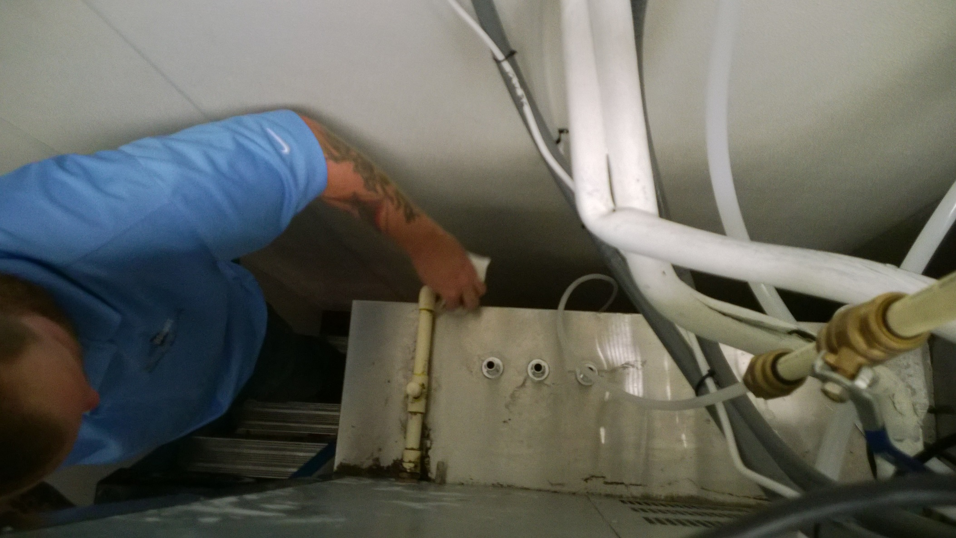
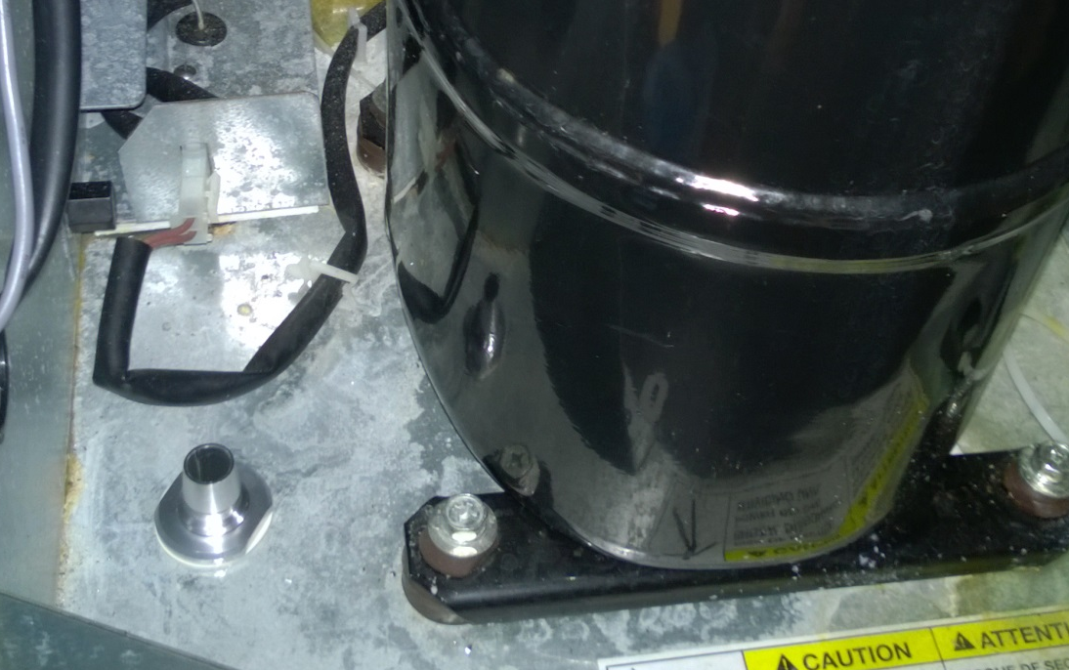
ICEZONE INSTALLATION
Mark the location for the Icezone return fitting. This is the fitting where the plasma will return to the Icezone.
This is typical located on the top of the ice bin (for multiple unit installations) or in the bottom of the ice machine (for single unit installations).
Icezone return fittings for
multiple ice machines / Icezones.
Icezone return fitting for single ice machine / Icezone.

Slide 9
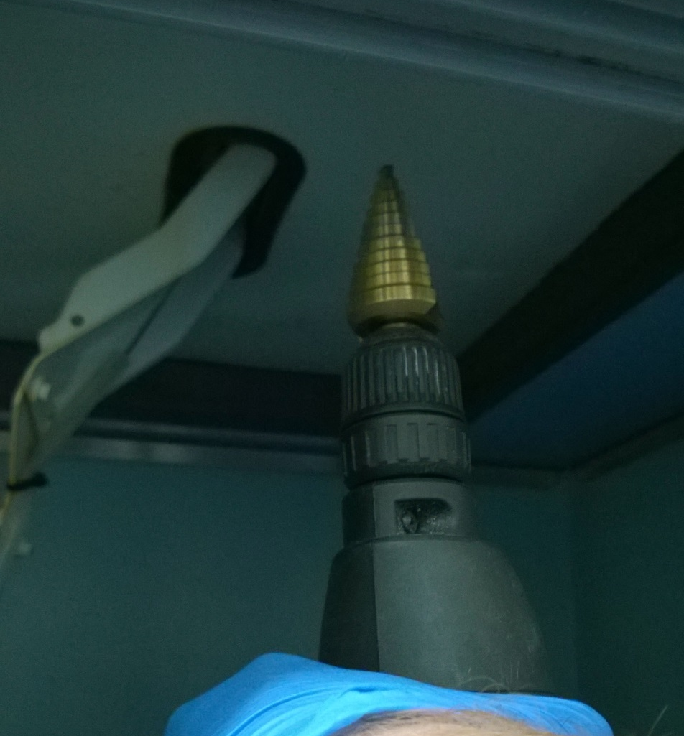
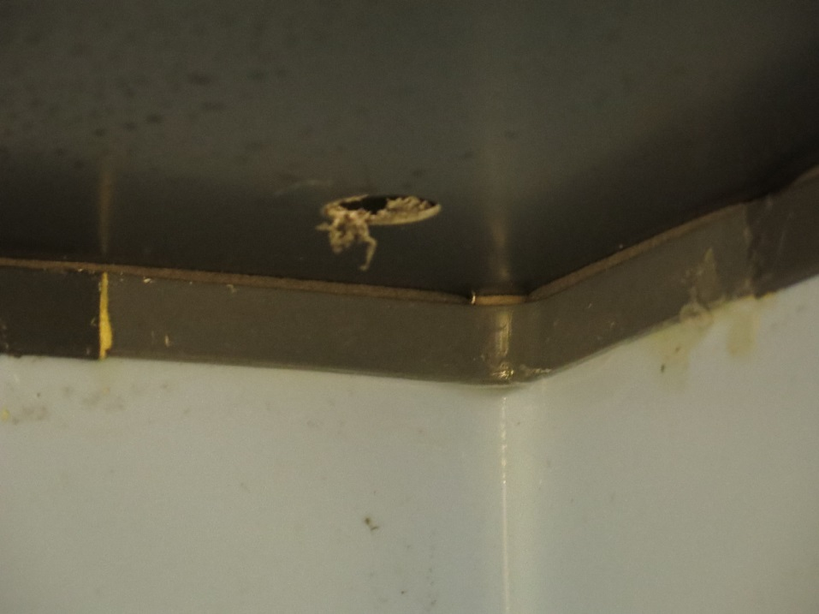
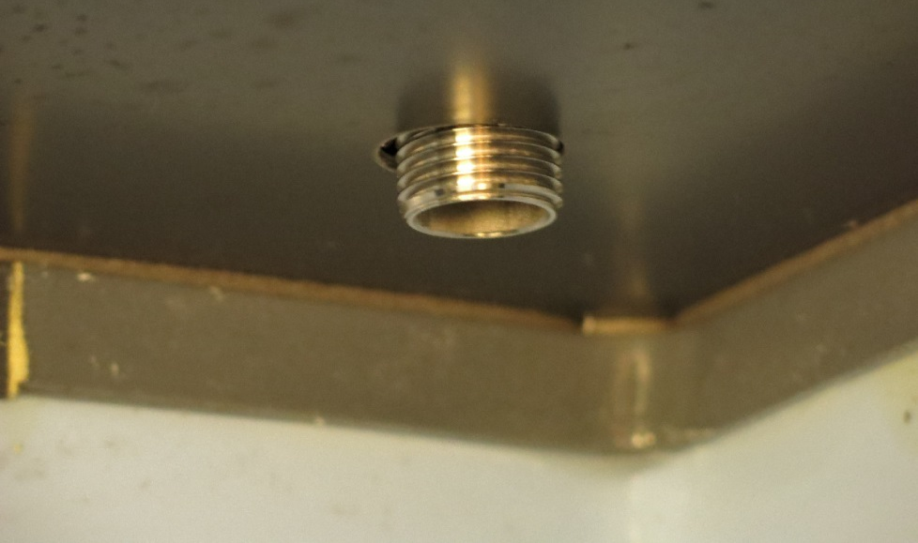
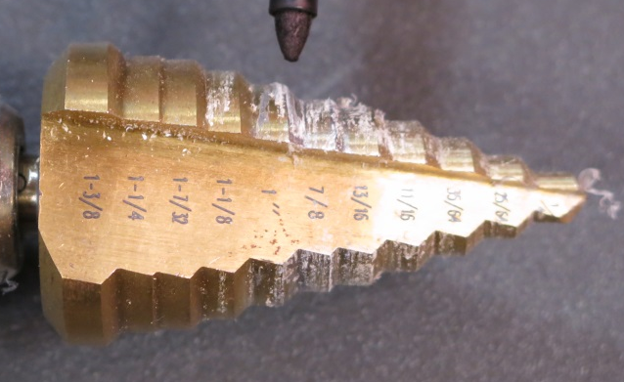
INSTALLING ICEZONE
FOR SINGLE MACHINE INSTALLATIONS
Drill the hole(s) as marked. The final hole diameter should be 1.0” for each fitting.
Clean the burrs from the hole edges and prepare to install the fittings.
This picture shows the de-burred hole with fitting inserted. (the fitting installation will be shown in the coming steps).

Slide 10
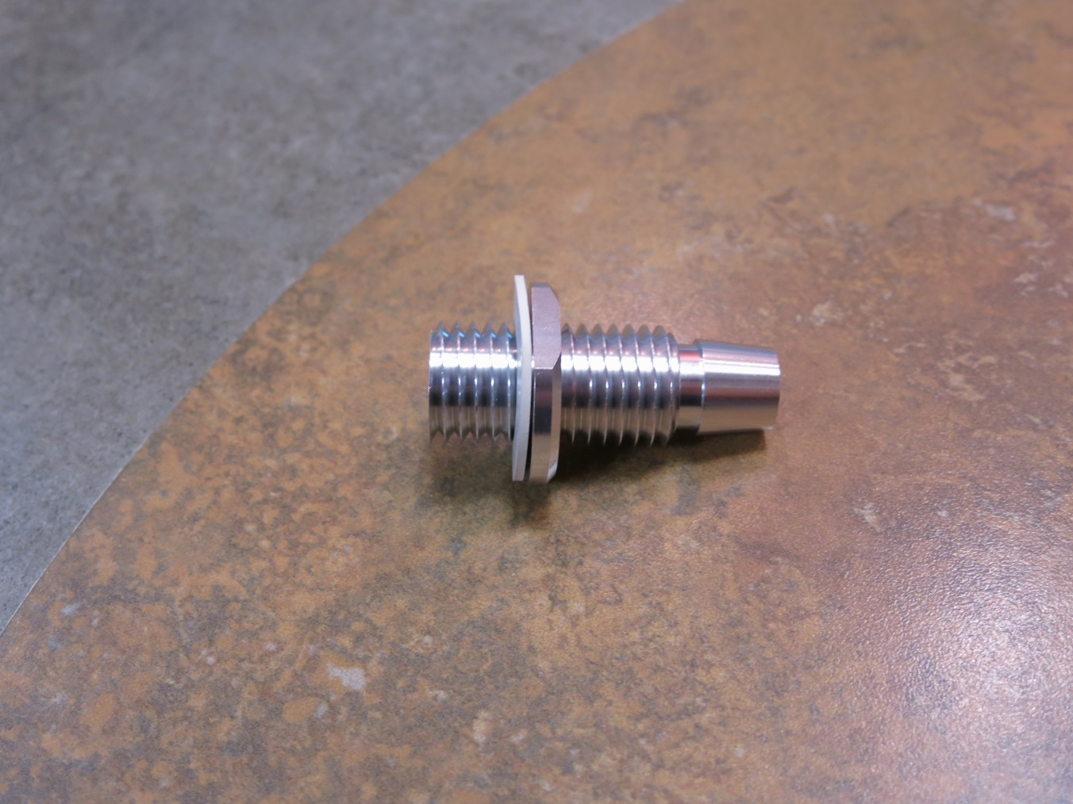
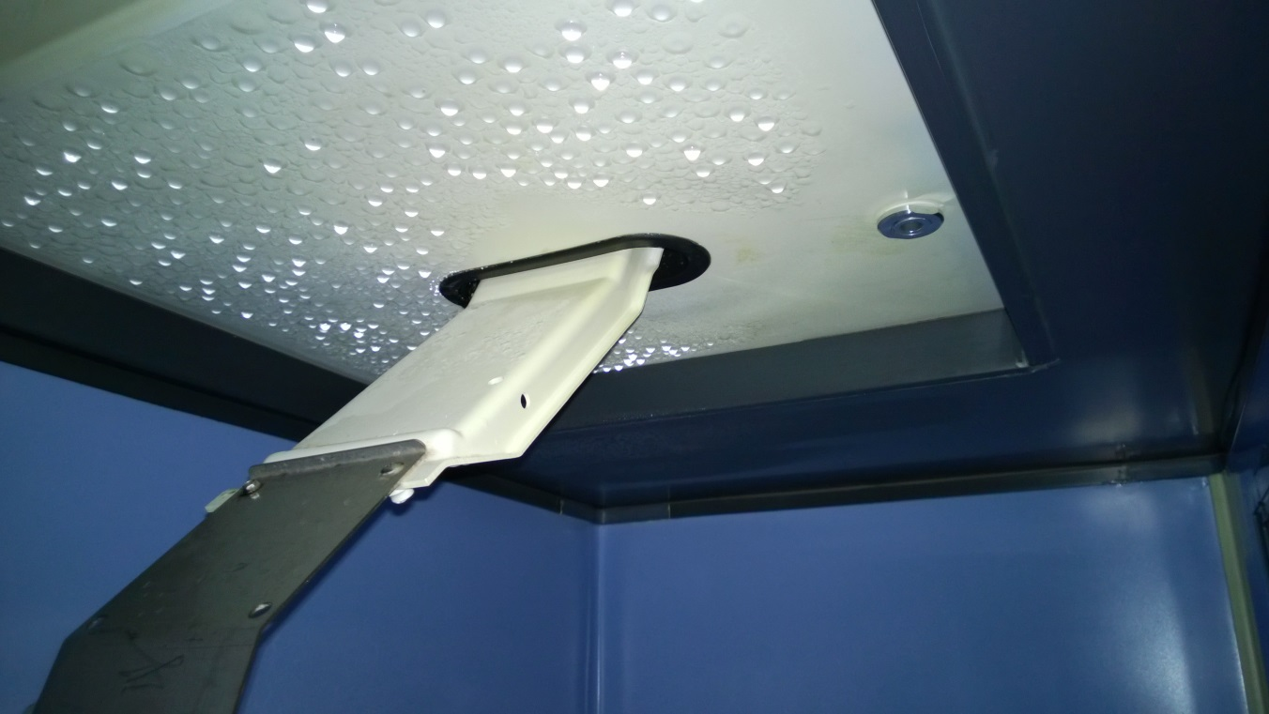
INSTALLING ICEZONE
FOR SINGLE MACHINE INSTALLATIONS
Assemble the return fitting as shown.
This includes a single ended barb fitting, low profile nut and white rubber washer.
Install the return fitting as shown.
This includes a second low profile nut and white rubber washer.
There should be no exposed threads on the interior surface of the lid per NSF guidelines.

Slide 11
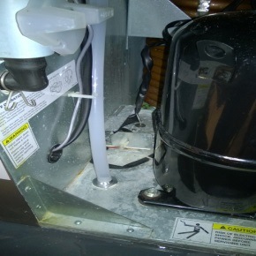
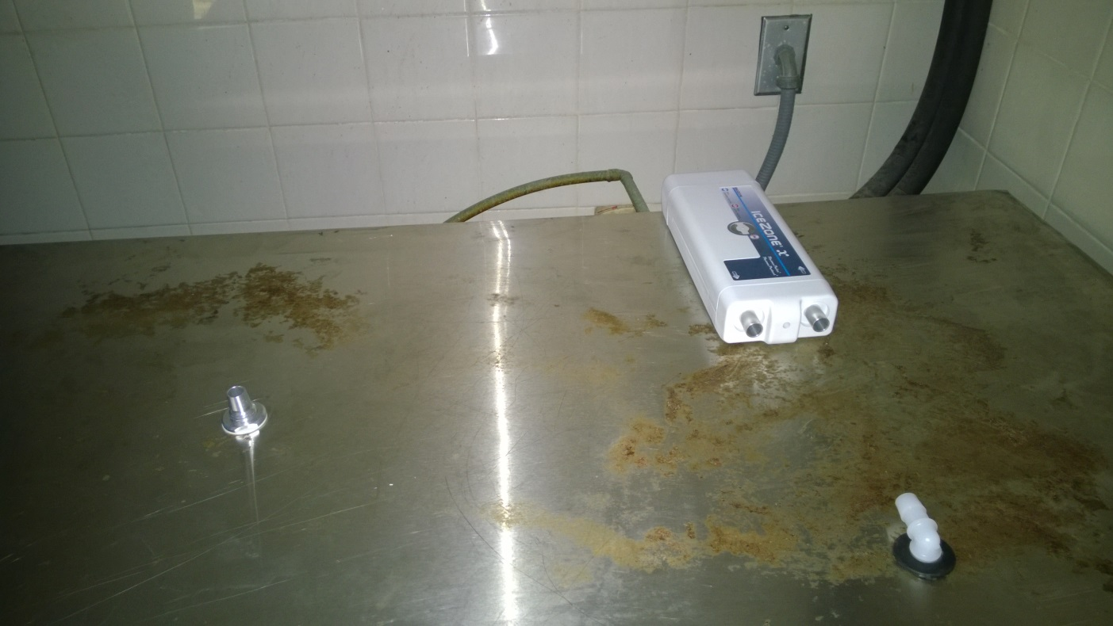
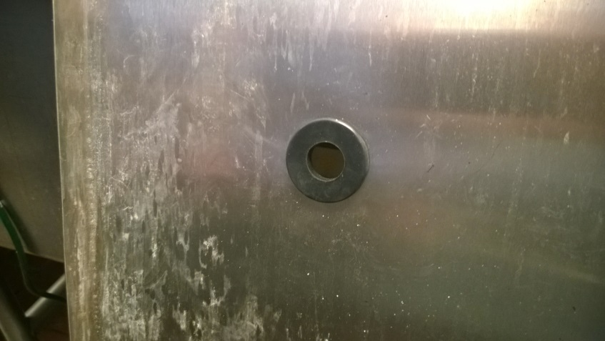
INSTALLING ICEZONE
FOR SINGLE MACHINE INSTALLATIONS
In single machine installations the return tubing will run from the bottom of the machine through the stainless-steel lid and to the Icezone.
A grommet is installed in the cover to allow the tubing to pass through.
For single machine installations, the top side of the lid should be completed as shown.
Ensure the fitting nuts are tight and prepare to mount the Icezone unit

Slide 12
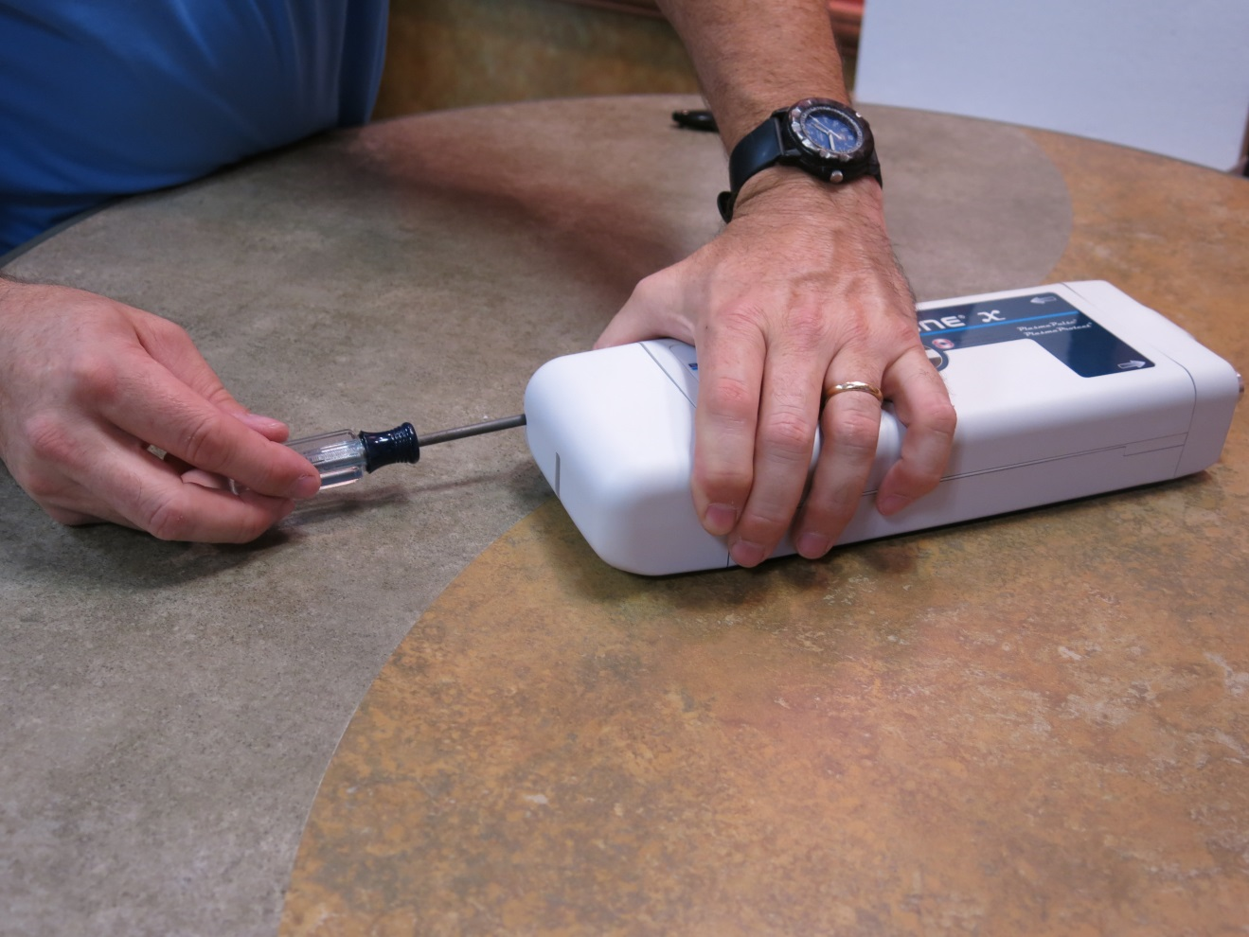
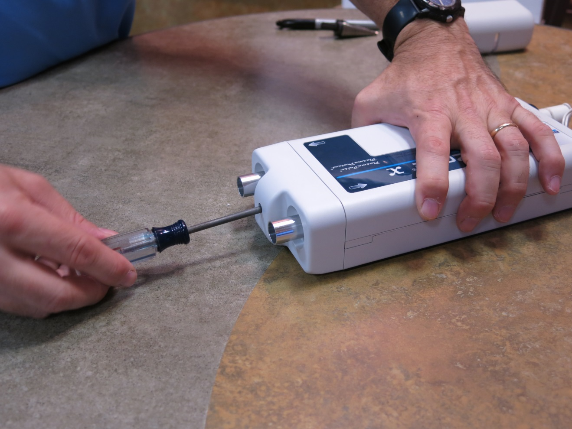
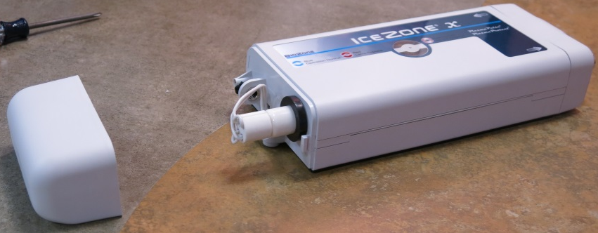
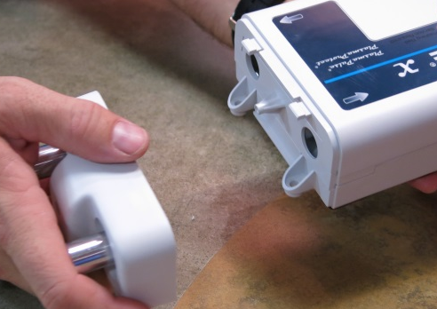
ICEZONE INSTALLATION
Remove the service cover from the Icezone unit.
This provides access to the lamp, power input and mounting boss.
As the screw is removed from the cover, be sure to keep it with the cover so it is available for re-assembly.
Remove the Input/Output cover from the Icezone unit.
This provides access to additional mounting bosses.
As the screw is removed from the cover, be sure to keep it with the cover so it is available for re-assembly.
The cover requires a firm pull while rotating towards the top for removal

Slide 13
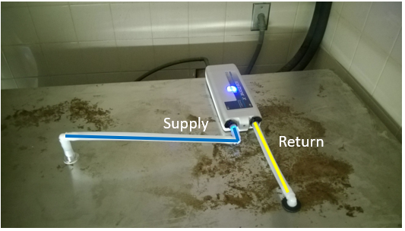
INSTALLING ICEZONE
FOR SINGLE MACHINE INSTALLATIONS
Place the Icezone Unit on the lid and layout the routing of the supply and return tubing.
The Icezone Unit should be placed in the back right corner of the cover (looking at the front of the ice machine)
Place the 90 degree hose barbs in place to visualize the routing. Observe the flow direction arrows on the Icezone Unit.

Slide 14
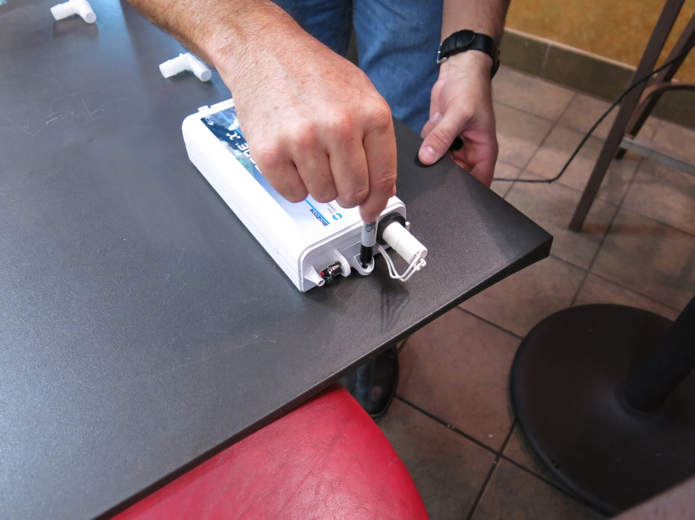
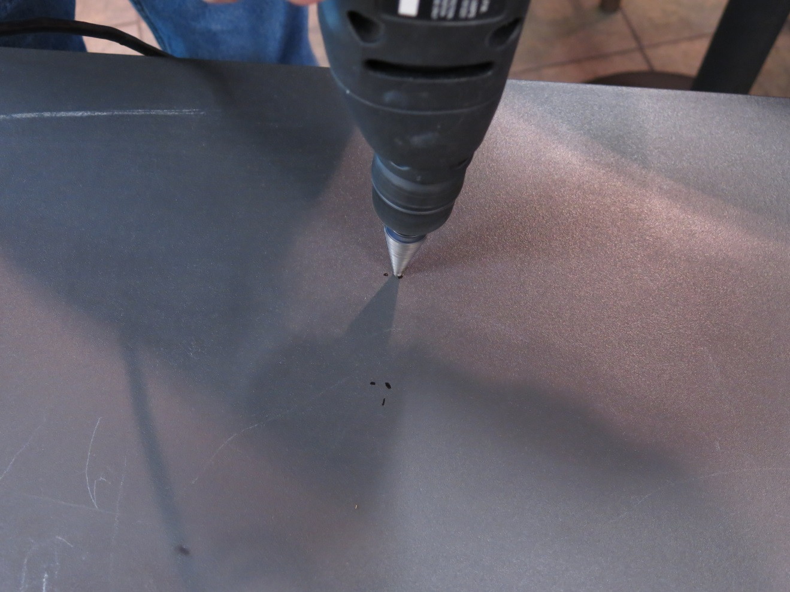
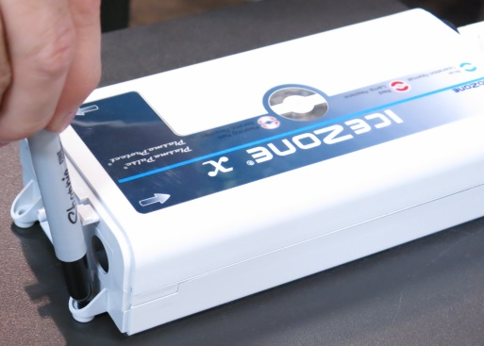
ICEZONE INSTALLATION
Mark the holes to mount the Icezone Unit on the lid.
Use a pen to locate the three mounting holes.
Drill the holes to mount the Icezone Unit on the lid.
Drill three 1/8” holes.

Slide 15
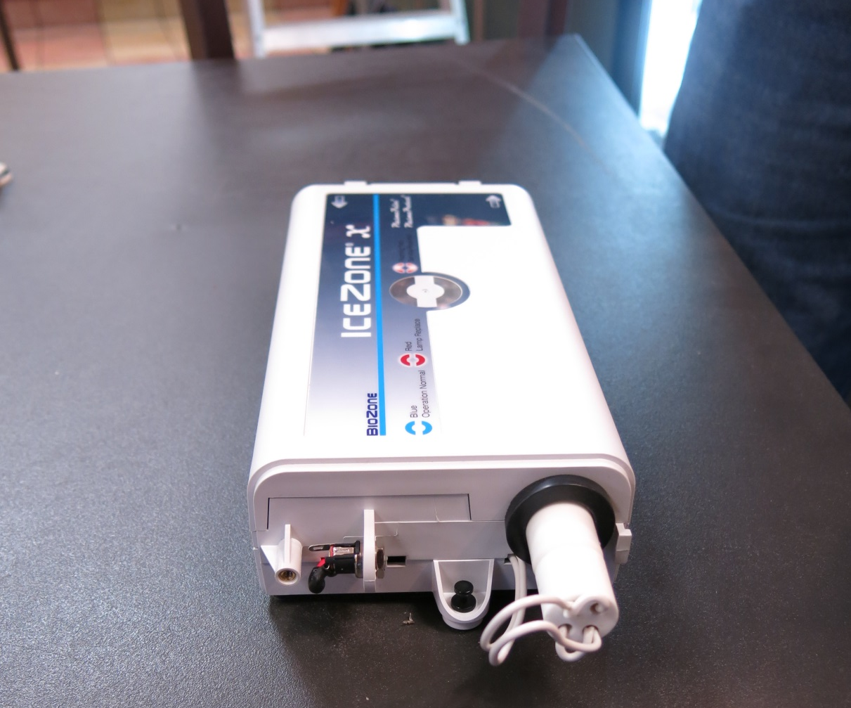

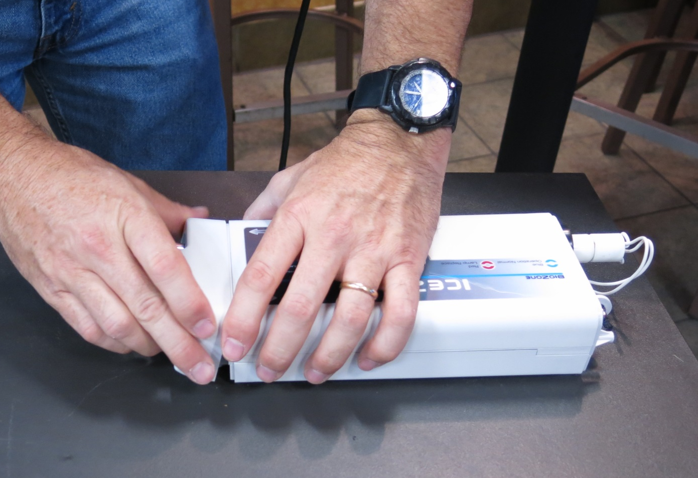
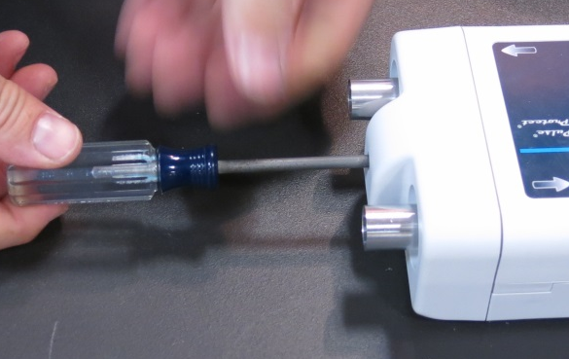
ICEZONE INSTALLATION
Place the mounting rivets or self drilling screws into the mounting holes.
Re-attach the Input/Output cover and secure with the original screw.

Slide 16
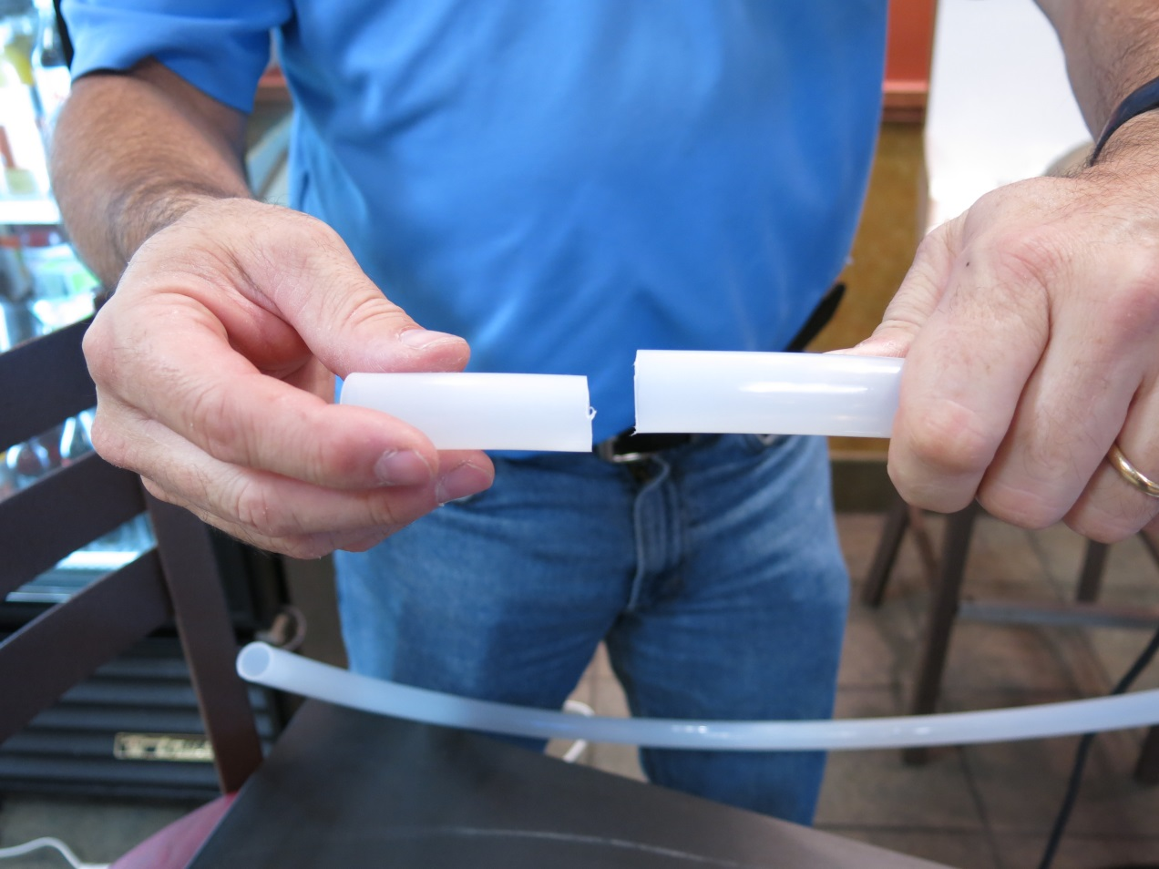
ICEZONE INSTALLATION
Cut two 2.5 inch pieces of tubing to connect the supply and return fittings to the 90 degree hose barbs.

Slide 17
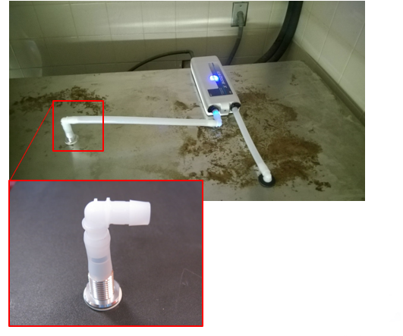
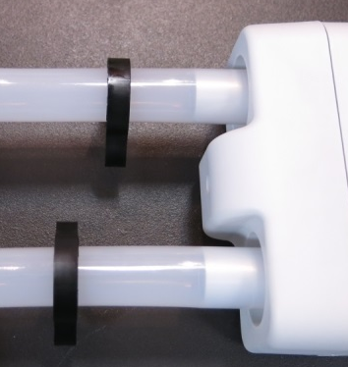
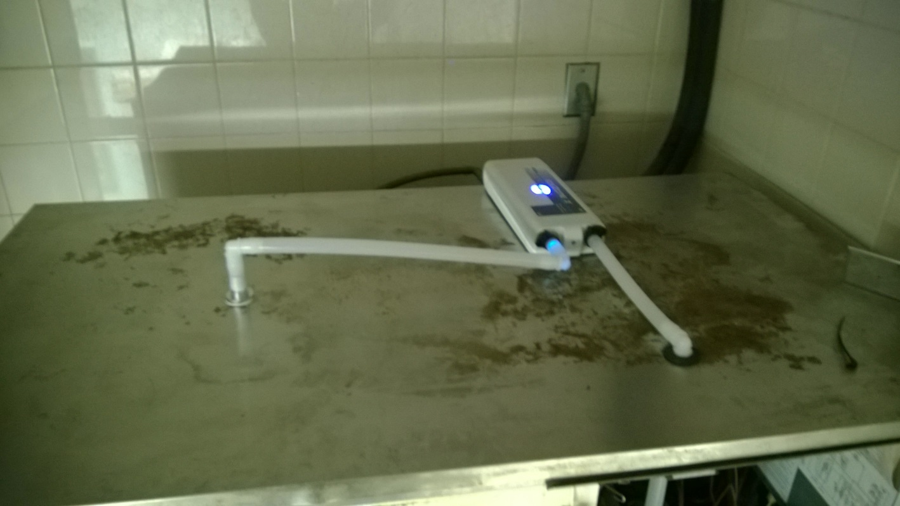
INSTALLING ICEZONE
FOR SINGLE MACHINE INSTALLATIONS
Cut two 2.5 inch pieces of tubing to connect the supply and return fittings to the 90 degree hose barbs.
Cut and assemble the remaining supply and return tubing and fittings.
Place the handy clamps (black) on the tubing which is placed over the ports on the Icezone Unit.
Installer’s Tip: Heating the tubing in hot water eases the installation of the tubing onto the fittings.

Slide 18
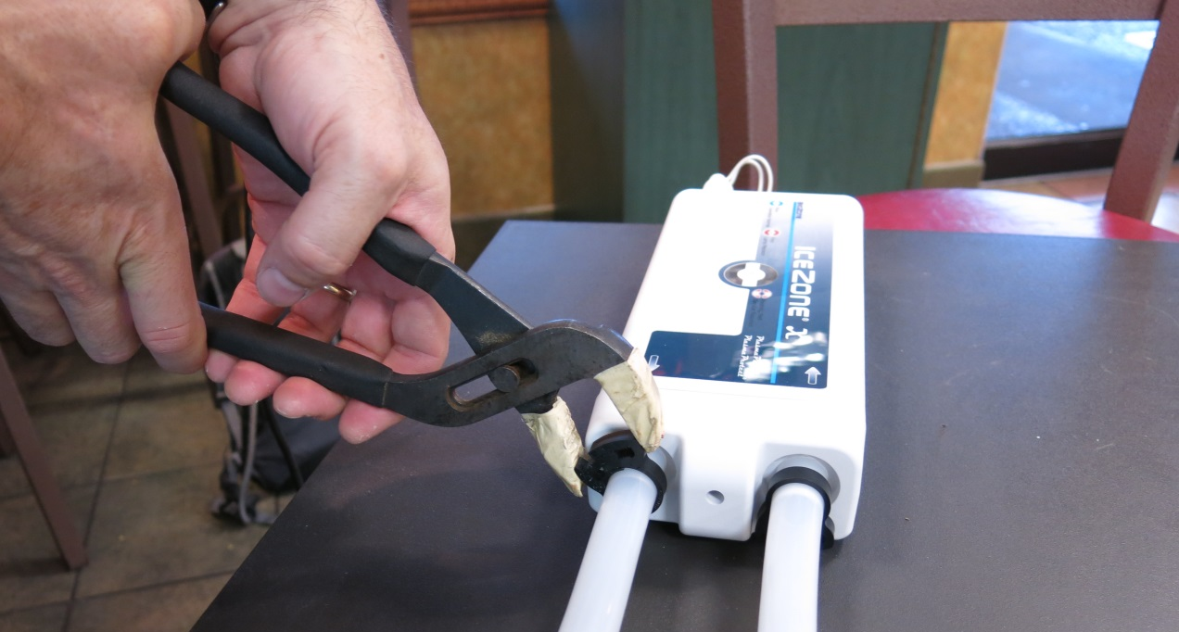
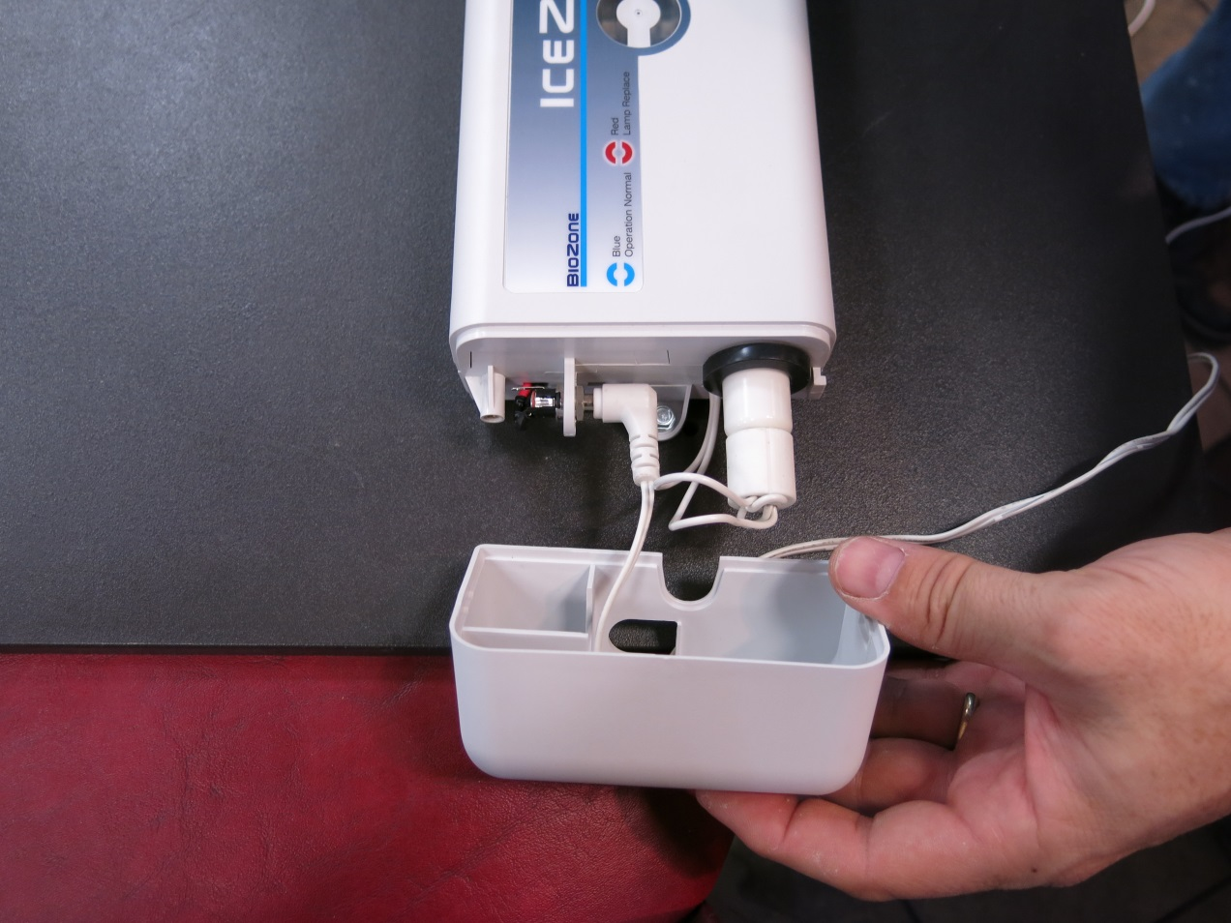
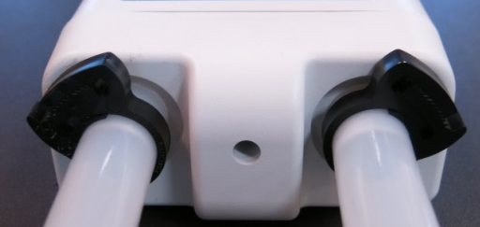
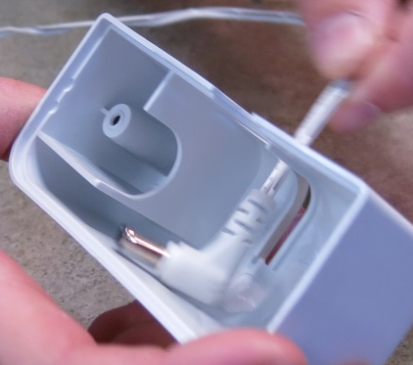
INSTALLING ICEZONE
FOR SINGLE MACHINE INSTALLATIONS
Tighten the handy clamps with a pliers to secure the tubing on the Icezone Unit.
Insert the DC plug from the wall adapter through the “P” shaped hole in the service cover.
Plug the DC connector into the Icezone Unit’s power input plug.

Slide 19
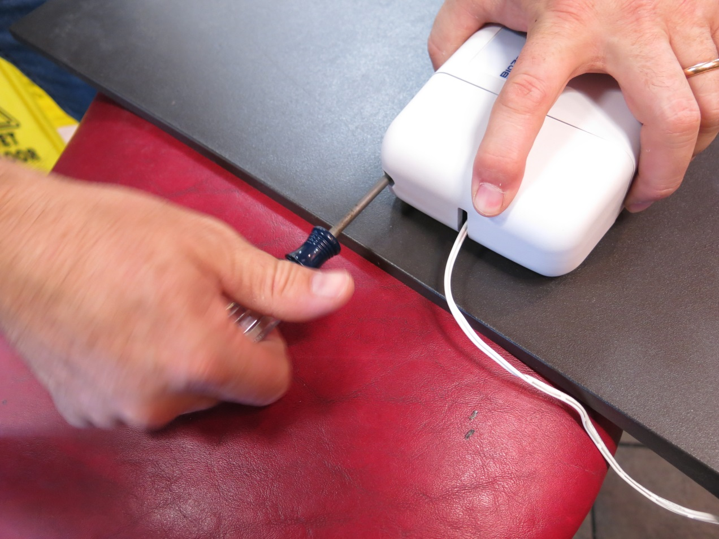
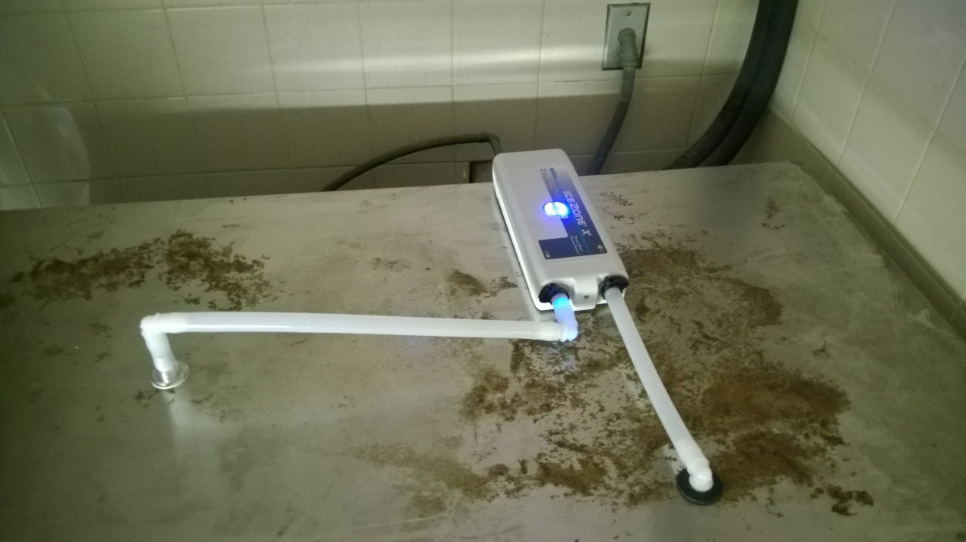
ICEZONE INSTALLATION
Reinstall the service cover and secure with the original screw.
The completed installation on the cover should look like the picture shown.

Slide 20
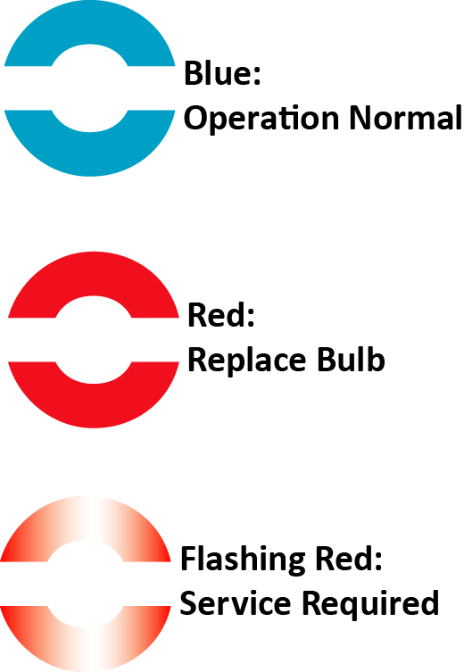
ICEZONE INSTALLATION
Close the ice machine after turning it on.
Plug the Icezone into a nearby 100VAC outlet that is not switched off.
The Icezone runs 24 hours/day, 7 days per
week.
Check to make sure the blue light is lit on the top of the Icezone.
When Icezone is connected to power correctly and the the operation is normal a blue light shows on top of the unit.
When the red light is steady on top of the Icezone, the lamp needs to be changed.
When the red light is flashing on top of the Icezone, the unit requires service.

Slide 21
Thank you for purchasing Icezone
Email: info@bsg-uv.com
Web: biozonescientific.com

