Slide 1

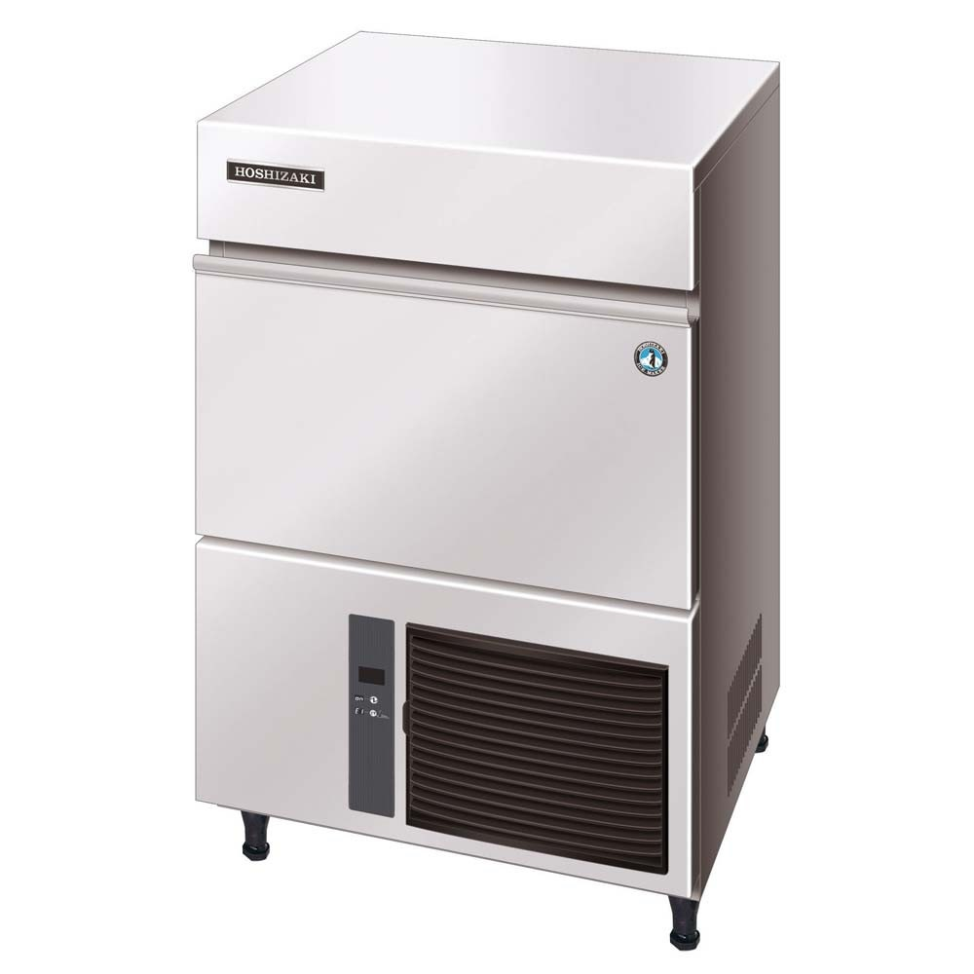

Icezone Installation Instructions for Hoshizaki IM 500 GRID Ice Machines
Please review the entire instructions prior to installation.
Caution: Installation should be done by a qualified technician using appropriate safety equipment and procedures.

Slide 2

INFORMATION
RECOMMENDED TOOLS
Follow the manufacturers guidelines for cleaning the ice and water dispenser thoroughly.
Before Installing Icezone, clean and sanitize the interior of the ice and water dispenser thoroughly according to the manufacturer’s guidelines. All surfaces should be free of slime and scale before starting the installation.
Hand Drill
Phillips Bit Driver
1” Step Drill Bit
¼” Nut Driver
25mm Hole Saw
Phillips Screwdriver
8-12 ft. Ladder
Safety Goggles
Hose Cutter or Utility Knife
1 ¼” Crescent Wrench
Pliers
Velcro 2 (1” X 8”) strips
Marker to mark hole locations
File or de-burring tool to de-burr holes

Slide 3
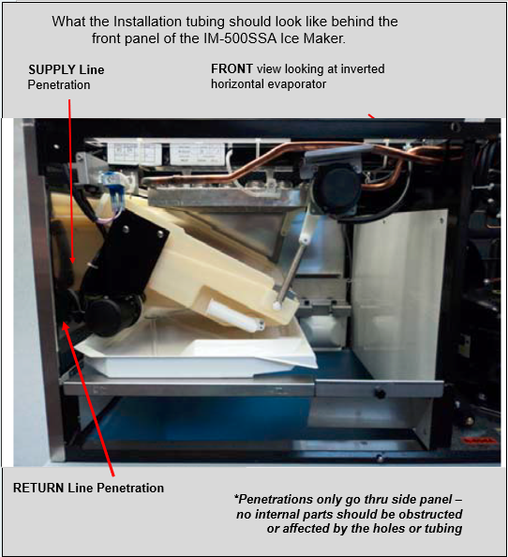
ICEZONE INSTALLATION
Turn the ice machine power switch to the “off” position until the installation is completed.
Mark the location for the Icezone Supply and Return fittings. The first step is to locate the hole on the stainless steel left side panel.
Transfer the location for the Icezone Supply and Return fittings to the insulated top cover.
Install the Supply and Return using the Black Grommets and Tubing
Remove the service cover from the Icezone unit. This provides access to the lamp and the power input. As the screw is removed from the cover, be sure to keep it with the cover so it is available for re-assembly.
Cut two 2 inch pieces of tubing to connect the Supply and Return fittings to the 90 degree elbows.
Cut and assemble the remaining Supply and Return tubing. Place the handy clamps (black) on the tubing which is placed over the ports on the Icezone Unit and tighten to secure. Use Velcro to secure unit to the surface on the panel.
Insert the DC plug from the wall adapter through the “P” shaped hole in the service cover. Plug the DC connector into the Icezone Unit’s power input plug.
Reinstall the service cover to the Icezone.
Connect the adapter to the wall outlet to power the Icezone.

Slide 4
Thank you for purchasing Icezone
Email: info@bsg-uv.com
Web: biozonescientific.com

