Slide 1
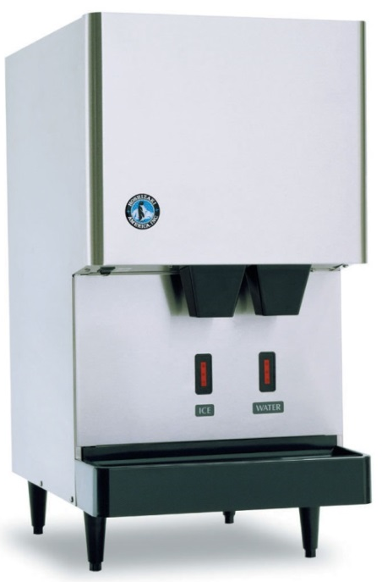


Icezone Installation Instructions for Hoshizaki DCM-270 Ice and Water Dispensers
Please review the entire instructions prior to installation.
Caution: Installation should be done by a qualified technician using appropriate safety equipment and procedures.

Slide 2

INFORMATION
RECOMMENDED TOOLS
Follow the manufacturers guidelines for cleaning the ice and water dispenser thoroughly.
Before Installing Icezone, clean and sanitize the interior of the ice and water dispenser thoroughly according to the manufacturer’s guidelines. All surfaces should be free of slime and scale before starting the installation.
Hand Drill
Phillips Bit Driver
1/8” Drill Bit
½” Drill Bit
1 1/8” Step Drill Bit
¼” Nut Driver
Phillips Screwdriver
Safety Goggles
Hose Cutter or Utility Knife
Channel Lock Pliers
Marker to mark hole locations
File or de-burring tool to de-burr holes

Slide 3
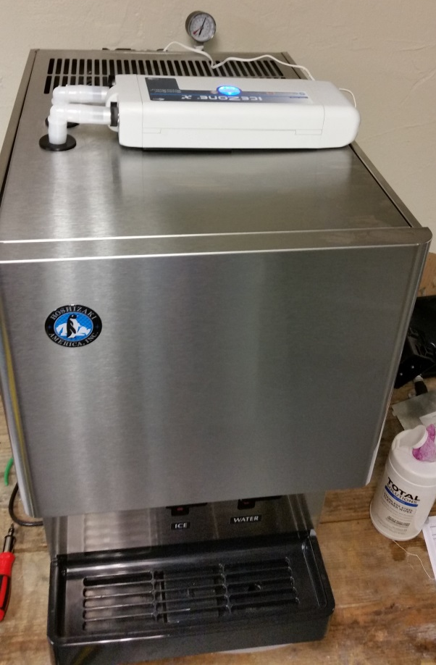
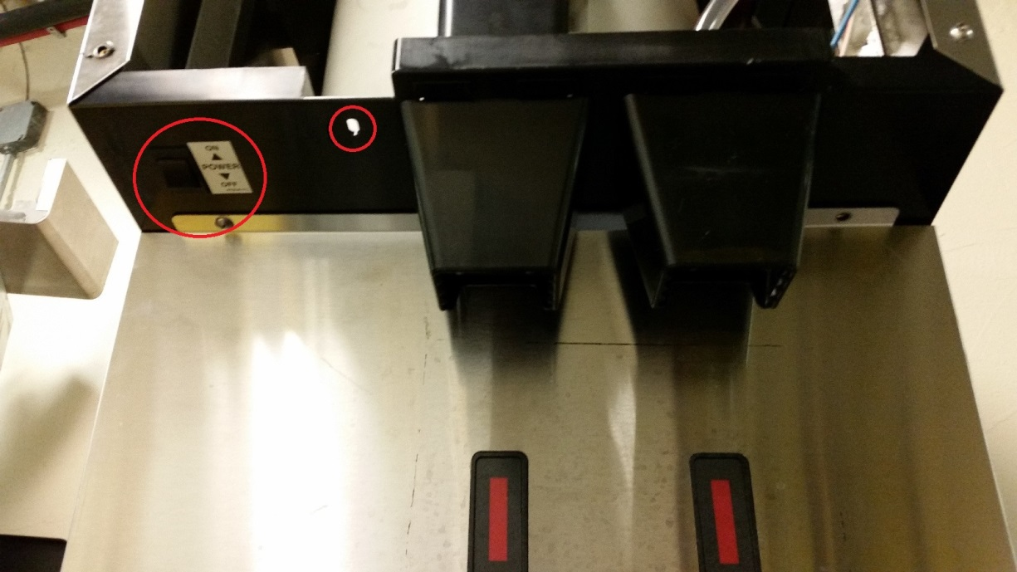
OVERVIEW
This is a Hoshizaki® DCM-270 Model Ice and Water Dispenser with Icezone installed.
Switch the power to the dispenser to “off” and unplug from the power source.

Slide 4
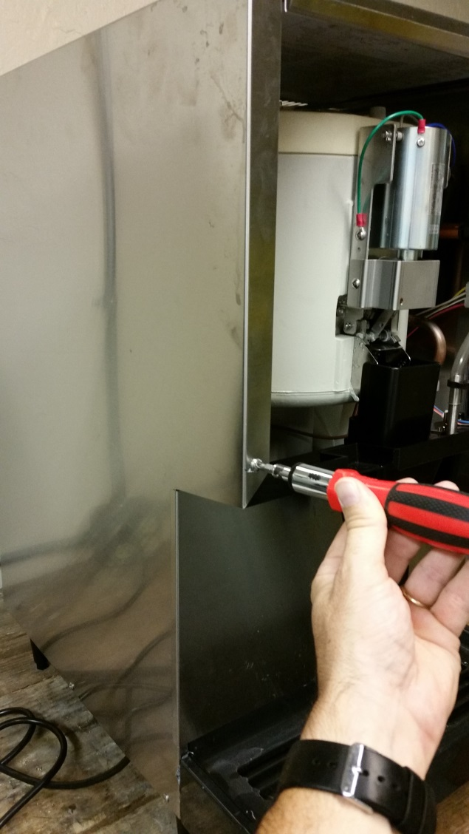
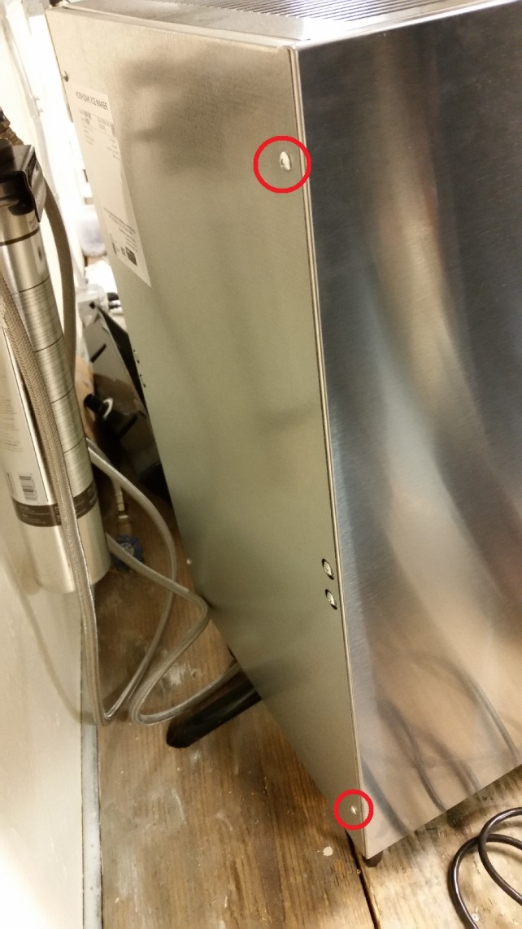
PREPARING THE UNIT
Remove the exterior covers to access the interior of the dispenser.

Slide 5
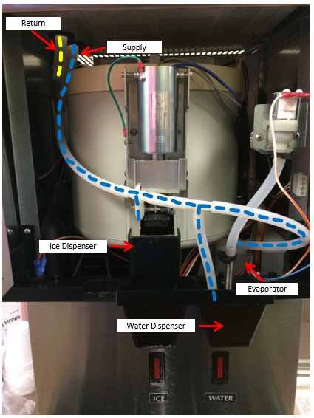
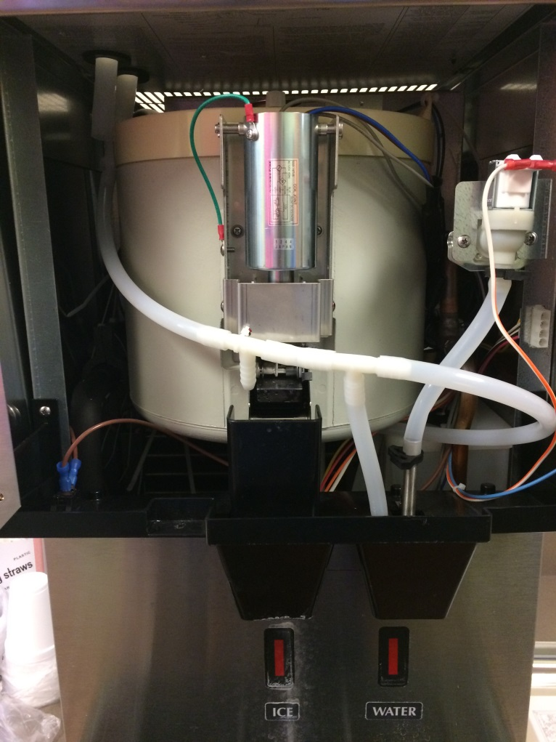
PREPARING THE UNIT
Note the following paths and locations:
Supply Line
Treatment Areas, including:
Ice Dispenser
Water Dispenser
Evaporator
Return Line
Note the short segment of tubing extends down

Slide 6
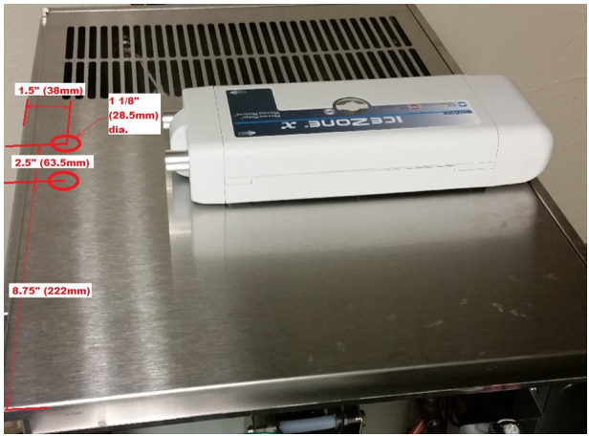
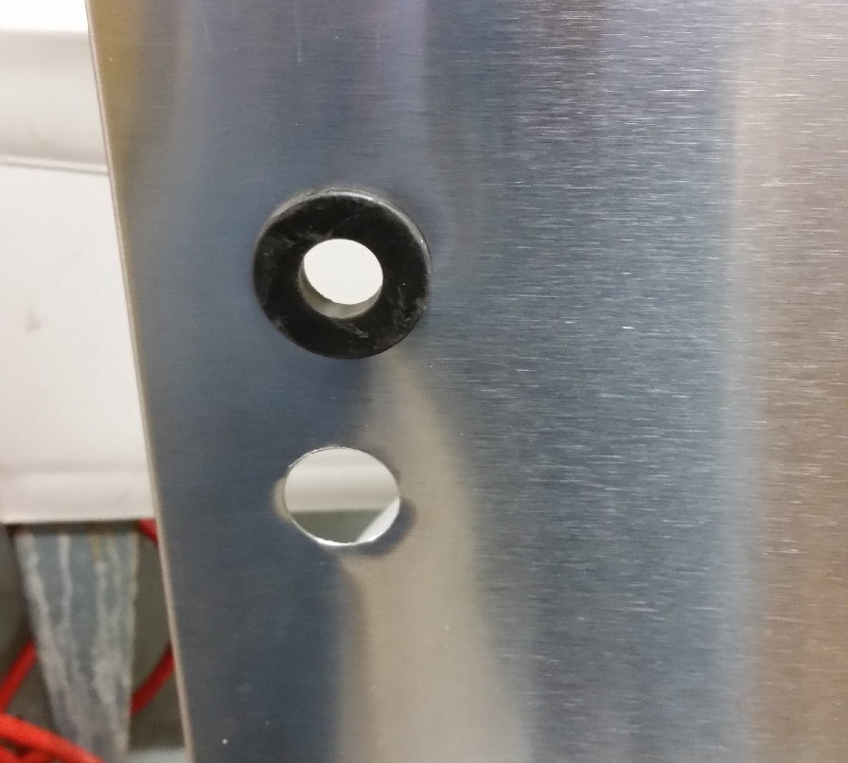
ICEZONE INSTALLATION
Locate the 2 holes for the Icezone supply and return tubing grommets with the dimensions shown.
Drill the 2 holes for the Icezone supply and return tubing grommets with a 1 1/8” step drill.
Remove the cover while drilling to prevent debris from contaminating the dispenser.
Deburr the holes and install the grommets as shown.

Slide 7
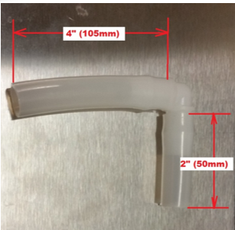
ICEZONE INSTALLATION
Remove the service cover from the Icezone unit.
This provides access to the lamp, power input and mounting boss.
As the screw is removed from the cover, be sure to keep it with the cover so it is available for re-assembly.
Cut the lengths for the Icezone supply and return 5/8” ID tubing with the dimensions shown. Install tubing on the 90 degree elbows.
Installer’s Tip: Heating the tubing in hot water eases the installation of the tubing onto the fittings.

Slide 8
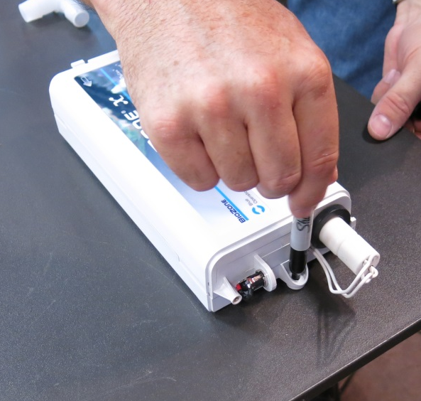
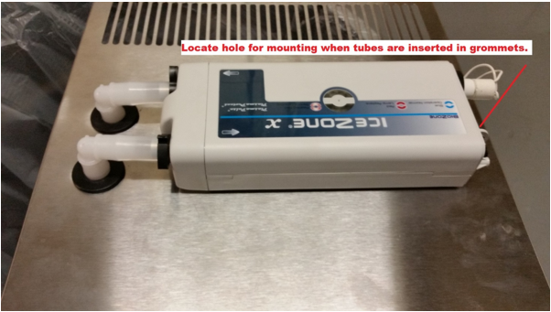
ICEZONE INSTALLATION
Install the Icezone supply and return 5/8” ID tubing as shown.
Use the location of the Icezone with tubing installed in grommets to locate the mounting hole.
Mark the hole to mount the Icezone unit on the panel. Use a pen to locate the mounting hole.
Drill a 1/8” hole.

Slide 9
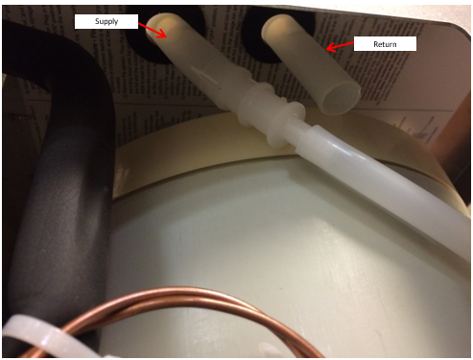
ICEZONE INSTALLATION
Place the mounting rivet into the mounting hole.
Install the 5/8” to 3/8” reducer fitting into the supply line 5/8” tubing inside the dispenser enclosure.

Slide 10
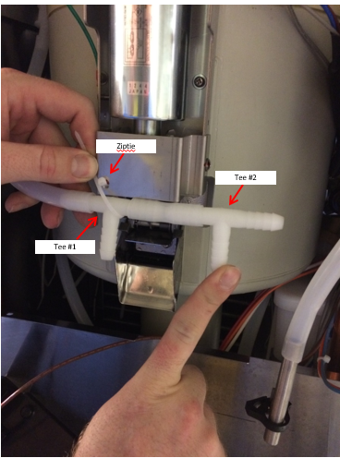
ICEZONE INSTALLATION
Remove the Ice Dispenser and Water Dispenser Tray (not pictured)
Route supply tubing to reach Ice Dispenser
Attach Tee fitting #1 to supply line
Cut approximately 2” of tubing and attach to Tee fitting #1
Attach Tee fitting #2 to 2” supply line segment
Attach zip tie to secure Tee fitting #1 to Ice Dispenser bracket as pictured

Slide 11
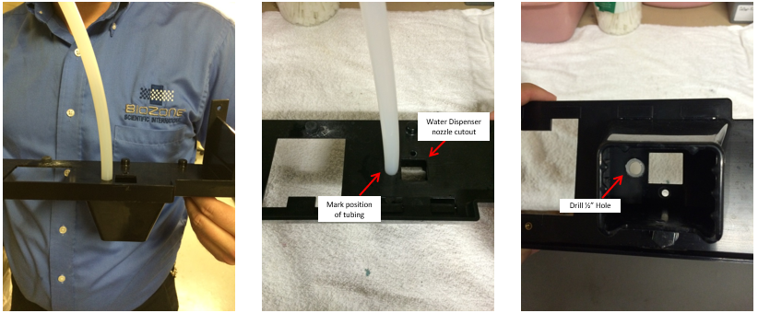
ICEZONE INSTALLATION
Mark position of Water Dispenser segment on Tray
Drill ½” hole in Tray next to Water Dispenser nozzle cutout

Slide 12
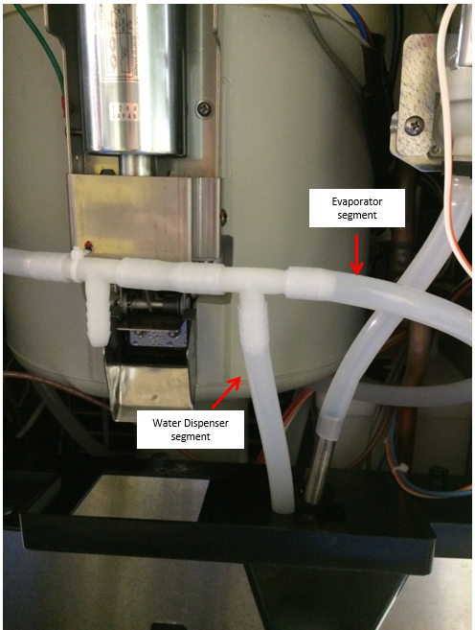
ICEZONE INSTALLATION
Installing Supply Line Water Dispenser Segment
Route supply tubing to reach Ice and Water Dispenser Tray
Cut tubing to length (approximately 6” of tubing)
Connect the supply segment to treat the Water Dispenser
Installing Supply Line Evaporator Segment
Route supply tubing to reach Evaporator area
Cut tubing to length (approximately 10” of tubing)
Connect the supply segment to treat the Evaporator area

Slide 13
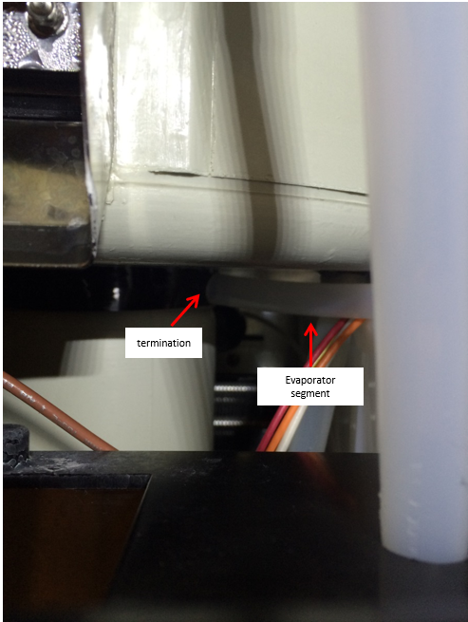
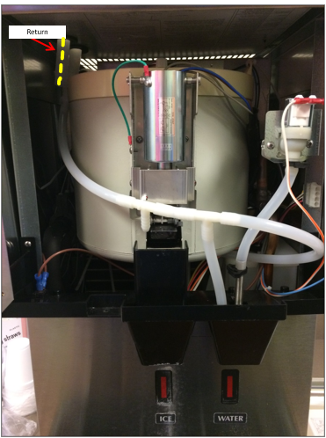
ICEZONE INSTALLATION
Install an approximately 5” segment of 5/8” tubing to drop the return line to near the top of the mechanical area (see yellow dotted line in accompanying image)
Evaporator area supply segment should terminate next to the Evaporator area

Slide 14
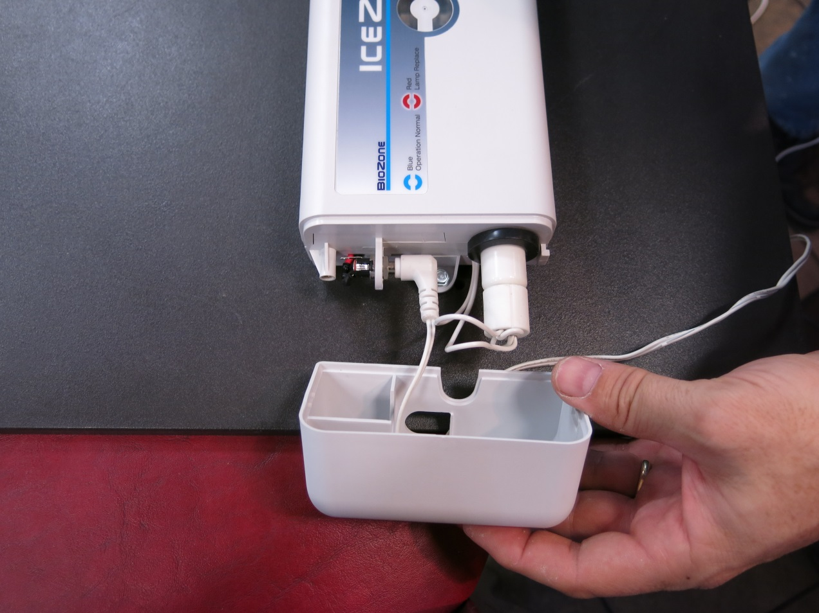
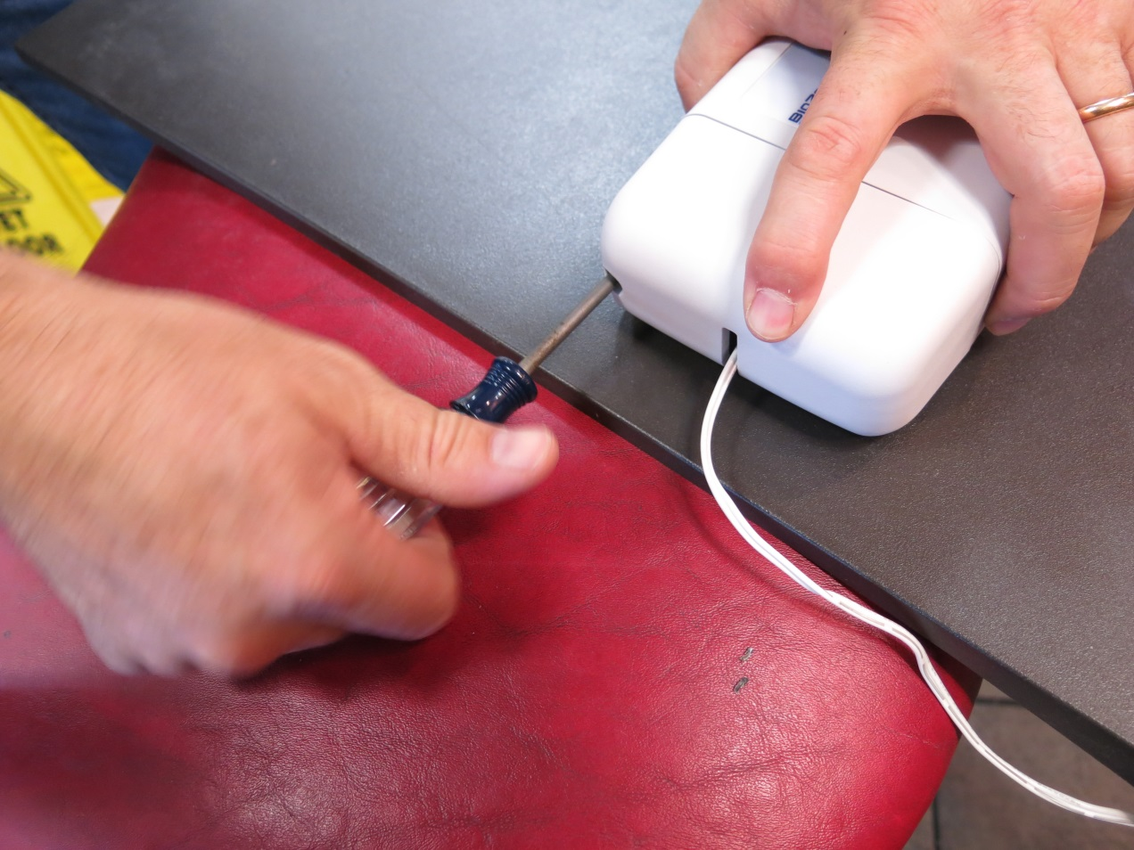
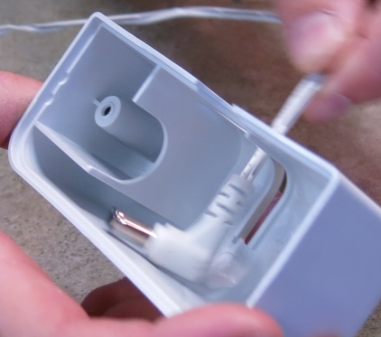
ICEZONE INSTALLATION
Insert the DC plug from the wall adapter through the “P” shaped hole in the service cover.
Plug the DC connector into the Icezone Unit’s power input plug.
Reinstall the service cover and secure with the original screw.

Slide 15
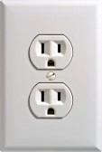
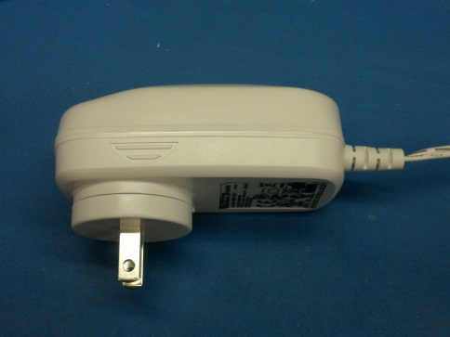
ICEZONE INSTALLATION
Icezone comes with a standard NEMA 1-15 ungrounded (Type A) wall adapter that can be powered with a 100-240V AC 50/60Hz wall plug (NEMA 1 or NEMA 5 outlet).

Slide 16
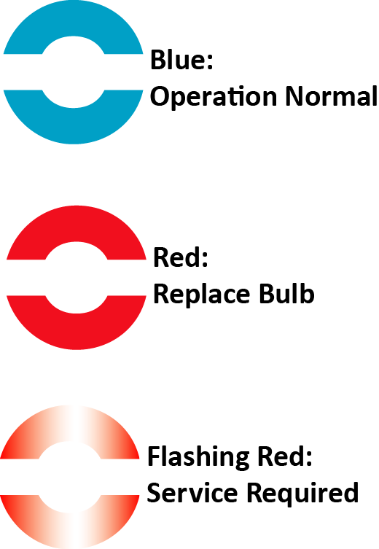
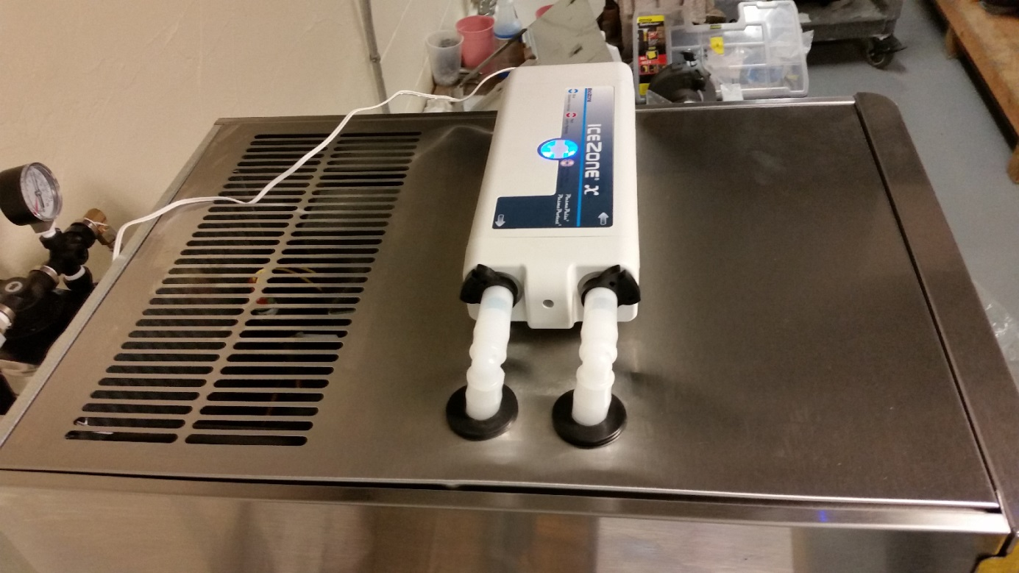
ICEZONE INSTALLATION
Close the ice machine after turning it on.
Plug the Icezone into a nearby 100VAC outlet that is not switched off.
The Icezone runs 24 hours/day, 7 days per
week.
Check to make sure the blue light is lit on the top of the Icezone.
When Icezone is connected to power correctly and the the operation is normal a blue light shows on top of the unit.
When the red light is steady on top of the Icezone, the lamp needs to be changed.
When the red light is flashing on top of the Icezone, the unit requires service.

Slide 17
Thank you for purchasing Icezone
Email: info@bsg-uv.com
Web: biozonescientific.com

